Slide 1
D_1_Objdump逆向工程技術

Slide 2
解讀關鍵組合語言

Slide 3
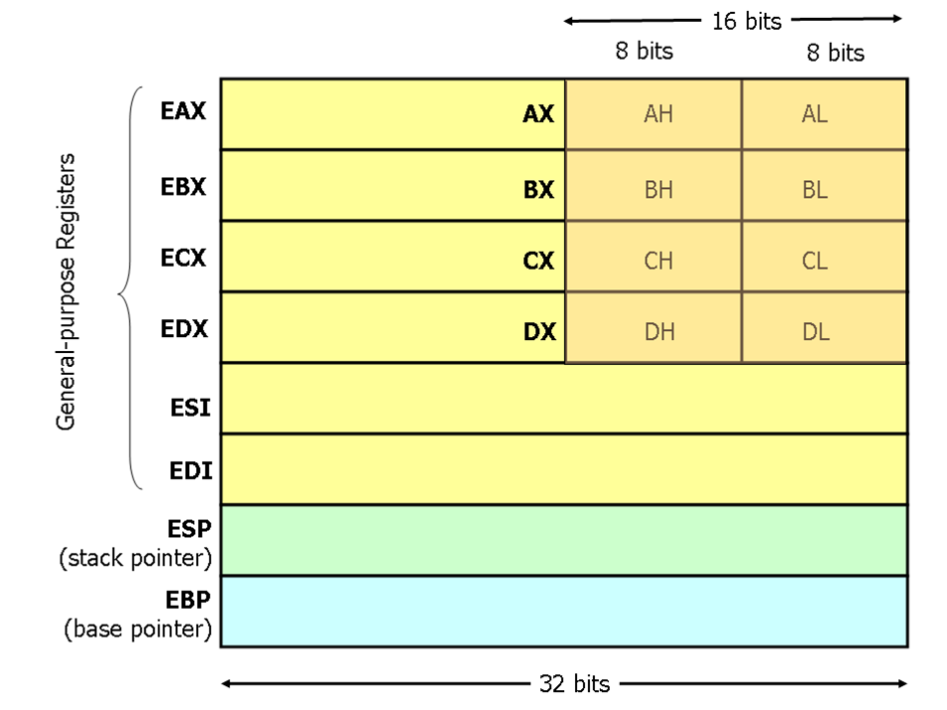

Slide 4
CPU
Register
Memory 記憶體
64bit
32bit
暫存器
RAX
RBX
RCX
RDX
暫存器
EAX
EBX
ECX
EDX
0
MOV destination , source
mov eax , 0
eax <-- 0
兩個運算元必須具有相同的大小。
兩個運算元不能都是記憶體運算元。
指令指標暫存器(IP 、EIP 、RIP) 不可以當作目的運算元。

Slide 5
HOWTO
產生
關鍵組合語言

Slide 6
Ｃ程式
gcc -S -masm=intel my_XXX.c -o my_XXX.s
-fno-asynchronous-unwind-tables
gcc my_XXX.c -o my_XXX -g
gcc my_XXX.c -o my_XXX
Intel格式的組合程式
反組譯的
組合程式
./my_XXX
objdump –S -D -M intel ./my_XXX
objdump -S -j .text -M intel helloCTFer --no-show-raw-insn
執行檔
ELF格式
gdb ./my_XXX
set disassembly-flavor intel

Slide 7
objdump -S helloCTFer
注意編譯時要加gcc helloCTFer.c -o helloCTFer -g
printf("Hello CTFer\n");
5a9: 83 ec 0c sub $0xc,%esp
5ac: 8d 90 50 e6 ff ff lea -0x19b0(%eax),%edx
5b2: 52 push %edx
5b3: 89 c3 mov %eax,%ebx
5b5: e8 36 fe ff ff call 3f0 <puts@plt>
5ba: 83 c4 10 add $0x10,%esp
return 0;
5bd: b8 00 00 00 00 mov $0x0,%eax
}
5c2: 8d 65 f8 lea -0x8(%ebp),%esp
5c5: 59 pop %ecx
5c6: 5b pop %ebx
5c7: 5d pop %ebp
5c8: 8d 61 fc lea -0x4(%ecx),%esp
5cb: c3 ret
00000590 <main>:
#include <stdio.h>
int main()
{
590: 8d 4c 24 04 lea 0x4(%esp),%ecx
594: 83 e4 f0 and $0xfffffff0,%esp
597: ff 71 fc pushl -0x4(%ecx)
59a: 55 push %ebp
59b: 89 e5 mov %esp,%ebp
59d: 53 push %ebx
59e: 51 push %ecx
59f: e8 28 00 00 00 call 5cc <__x86.get_pc_thunk.ax>
5a4: 05 5c 1a 00 00 add $0x1a5c,%eax

Slide 8
objdump -S -M intel helloCTFer
00000590 <main>:
#include <stdio.h>
int main()
{
590: 8d 4c 24 04 lea ecx,[esp+0x4]
594: 83 e4 f0 and esp,0xfffffff0
597: ff 71 fc push DWORD PTR [ecx-0x4]
59a: 55 push ebp
59b: 89 e5 mov ebp,esp
59d: 53 push ebx
59e: 51 push ecx
59f: e8 28 00 00 00 call 5cc <__x86.get_pc_thunk.ax>
5a4: 05 5c 1a 00 00 add eax,0x1a5c
記憶體位址
機器碼
組合語言

Slide 9
objdump -S -j .text -M intel helloCTFer --no-show-raw-insn
去掉機器碼
00000590 <main>:
#include <stdio.h>
int main()
{
590: lea ecx,[esp+0x4]
594: and esp,0xfffffff0
597: push DWORD PTR [ecx-0x4]
59a: push ebp
59b: mov ebp,esp
59d: push ebx
59e: push ecx
59f: call 5cc <__x86.get_pc_thunk.ax>
5a4: add eax,0x1a5c
printf("Hello CTFer\n");
5a9: sub esp,0xc
5ac: lea edx,[eax-0x19b0]
5b2: push edx
5b3: mov ebx,eax
5b5: call 3f0 <puts@plt>
5ba: add esp,0x10
return 0;
5bd: mov eax,0x0
}
5c2: lea esp,[ebp-0x8]
5c5: pop ecx
5c6: pop ebx
5c7: pop ebp
5c8: lea esp,[ecx-0x4]
5cb: ret
組合語言
記憶體位址

Slide 11
int main(){
}
00000560 <main>:
int main(){}
560: push ebp
561: mov ebp,esp
563: call 574 <__x86.get_pc_thunk.ax>
568: add eax,0x1a98
56d: mov eax,0x0
572: pop ebp
573: ret
00000574 <__x86.get_pc_thunk.ax>:
574: mov eax,DWORD PTR [esp]
577: ret
578: xchg ax,ax
57a: xchg ax,ax
57c: xchg ax,ax
57e: xchg ax,ax

Slide 12
#include <stdio.h>
int main(){
}
int main(){
}
00000560 <main>:
#include <stdio.h>
int main(){}
560: push ebp
561: mov ebp,esp
563: call 574 <__x86.get_pc_thunk.ax>
568: add eax,0x1a98
56d: mov eax,0x0
572: pop ebp
573: ret
00000574 <__x86.get_pc_thunk.ax>:
574: mov eax,DWORD PTR [esp]
577: ret
578: xchg ax,ax
57a: xchg ax,ax
57c: xchg ax,ax
57e: xchg ax,ax
00000560 <main>:
int main(){}
560: push ebp
561: mov ebp,esp
563: call 574 <__x86.get_pc_thunk.ax>
568: add eax,0x1a98
56d: mov eax,0x0
572: pop ebp
573: ret
00000574 <__x86.get_pc_thunk.ax>:
574: mov eax,DWORD PTR [esp]
577: ret
578: xchg ax,ax
57a: xchg ax,ax
57c: xchg ax,ax
57e: xchg ax,ax

Slide 13
000005a0 <main>:
#include<stdio.h>
int main(){
5a0: lea ecx,[esp+0x4]
5a4: and esp,0xfffffff0
5a7: push DWORD PTR [ecx-0x4]
5aa: push ebp
5ab: mov ebp,esp
5ad: push ebx
5ae: push ecx
5af: call 5dc <__x86.get_pc_thunk.ax>
5b4: add eax,0x1a4c
printf("Hello CTFer!");
5b9: sub esp,0xc
5bc: lea edx,[eax-0x19a0]
5c2: push edx
5c3: mov ebx,eax
5c5: call 400 <printf@plt>
5ca: add esp,0x10
5cd: mov eax,0x0
}
5d2: lea esp,[ebp-0x8]
5d5: pop ecx
5d6: pop ebx
5d7: pop ebp
5d8: lea esp,[ecx-0x4]
5db: ret
000005dc <__x86.get_pc_thunk.ax>:
5dc: mov eax,DWORD PTR [esp]
5df: ret
……………………………

